Slide 1

SOAR: Automated Assessment & Care Plan Construction

Slide 2
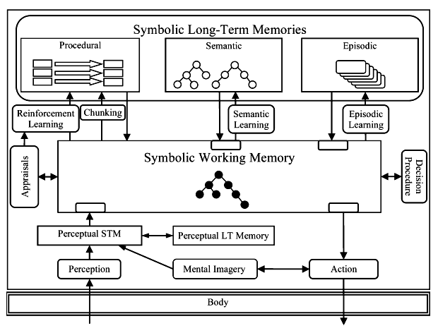
POC Architecture & Data
Omaha System KBS Problem Rating Scale (Knowledge, Behavior, Status)
Omaha System Problems Set (42)
Rating: | 1 | 2 | 3 | 4 | 5
Knowledge | Ignorant | Minimal | Basic | Adequate | Superior
Behavior | Inappropriate | Rarely Appropriate | Inconsistent | Usually Appropriate | Consistent
Status | Extremely Symptoms | Severely Symptoms | Moderately Symptoms | Minimal Symptoms | No Symptoms
1 I NCOME
2 SANITATION
3 RESIDENCE
4 NEIGHBORHOOD / WORKPLACE SAFETY
5 COMMUNICATION WITH COMMUNITY RESOURCES
6 SOCIAL CONTACT
7 ROLE CHANGE
8 INTERPERSONAL RELATIONSHIP
9 SPIRITUALITY
10 GRIEF
11 MENTAL HEALTH
12 SEXUALITY
13 CARETAKING/PARENTING
14 NEGLECT
15 ABUSE
16 GROWTH AND DEVELOPMENT
17 HEARING
18 VISION
19 SPEECH AND LANGUAGE
20 ORAL HEALTH
21 COGNITION
22 PAIN
23 CONSCIOUSNESS
24 SKIN
25 NEURO-MUSCULO-SKELETAL FUNCTION
26 RESPIRATION
27 CIRCULATION
28 DIGESTION-HYDRATION
29 BOWEL FUNCTION
30 URINARY FUNCTION
31 REPRODUCTIVE FUNCTION
32 PREGNANCY
33 POSTPARTUM
34 COMMUNICABLE / INFECTIOUS CONDITION
35 NUTRITION
36 SLEEP AND REST PATTERNS
37 PHYSICAL ACTIVITY
38 PERSONAL CARE
39 SUBSTANCE USE
40 FAMILY PLANNING
41 HEALTH CARE SUPERVISION
42 MEDICATION REGIMEN
Procedural Rules:
(What to do, When to do it, and How to do it )
Procedural
Rules
File: XXX Rules
Semantic Memory:
(Learning “facts” about the world)
Semantic
Memory
Ranked List:
Problems & Options
File: Graph of General Facts
Working Memory:
(How agents "think" and "behave")
OUTPUTS
Working
Memory
File: Graph of Specific Use-Case Facts
INPUTS

Slide 3
POC Architecture & Data
Omaha System Mapping to SOAR Rules
Omaha Taxonomy & OutcomesData
Aka: Knowledge Engineering
SOAR Taxonomy & Rules
Procedural Rules:
(What to do, When to do it, and How to do it )
Procedural
Rules
File: XXX#’s of Rules
Semantic Memory:
(Learning “facts” about the world)
Semantic
Memory
File: Graph of General Facts
Working Memory:
(How agents "think" and "behave")
Working
Memory
File: Graph of Specific Use-Case Facts

Slide 4
POC Architecture & Data
WORK OUTPUT(S)
Omaha Taxonomy & Outcomes Data
Progression Plan
Procedural
Rules
Compare against
Omaha Taxonomy
Procedural Rules:
(What to do, When to do it, and How to do it )
File: XXX#’s of Rules
Single Individual
case
Human Vetted Results
Semantic
Memory
Semantic Memory:
(Learning “facts” about the world)
File: Graph of General Facts
Multiple Individual
Case(s)
Working
Memory
Human Vetted Results
Working Memory:
(How agents "think" and "behave")
File: Graph of Specific Use-Case Facts

Slide 5
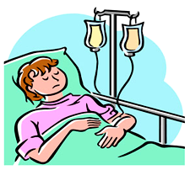
Proposed Process Flow
Compare against
Omaha Taxonomy
Potential Process Flow
SOAR Created Care Plan Artifacts
Human Vetted Results
SOAR Reasoning Articulation
Single Member
Use-Case
Other Important Artifacts

Slide 6
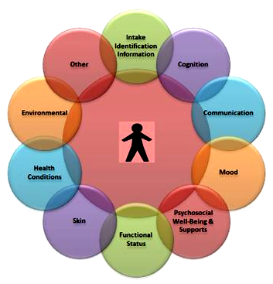
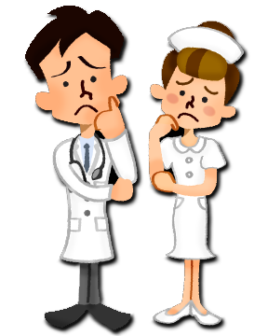
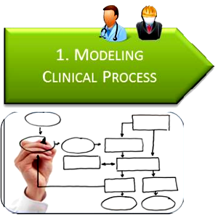

Use-Case Exploration: Pre-Diabetes (Assessments)
Use-Case:
Pre-Diabetes
Clinical Staff
Assessment
SOAR Artifacts
First Modeling
Procedural
Rules
<= Iterate =>
Intermediate
Clinical Rules KE Form
Semantic
Memory
SOAR PhD
Model Assessment Process
Knowledge Engineering
Working
Memory

Slide 7

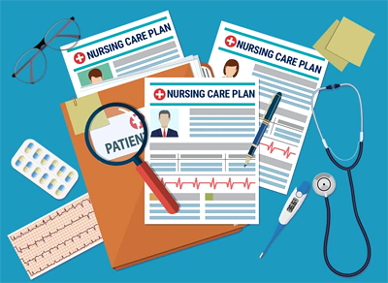
Use-Case Exploration: Pre-Diabetes (Care Plan Construction)
Second Modeling
<= Iterate =>
Intermediate
Clinical Rules KE Form
Model Care Plan Construction Process
Knowledge Engineering
SOAR Artifacts
Procedural
Rules
Semantic
Memory
Informs
SOAR PhD
Working
Memory
Member Assessment
Care Plan

Slide 8
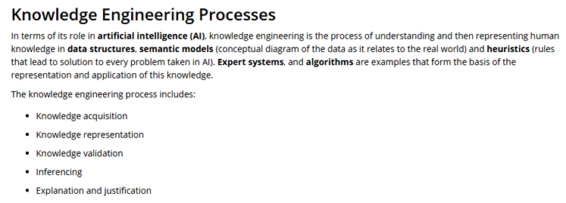
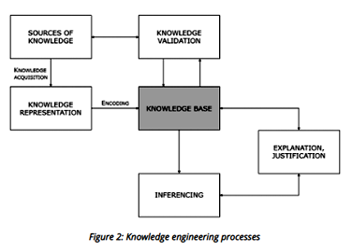
Use-Case Exploration: Pre-Diabetes (Knowledge Engineering)
SOAR

Slide 9

Use-Case Exploration: Pre-Diabetes (Knowledge Engineering)
Informs
Member Assessment
Care Plan
First Modeling
Second Modeling
Assessment Process
Care Plan Process
Artifacts from the Assessment Process
Artifacts from the Care Plan Process
Knowledge Engineering
Knowledge Engineering

Slide 10
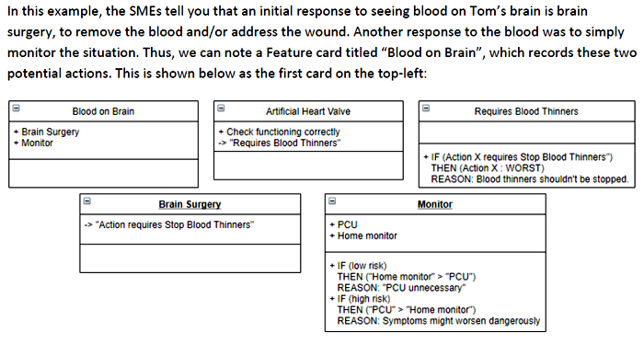
Use-Case Exploration: Pre-Diabetes (Knowledge Engineering)
Consider the following (non-diabetes) Example:
A CT scan shows that a patient, Tom, has blood on his brain. The default response would be surgery. However, Tom has an artificial heart valve that requires him to take blood thinners. Surgery would require him to stop taking blood thinners for one week post-op, and this would be dangerous. In this case, surgery is a last resort option, and the preferred response is to move him to a PCU for more frequent and thorough monitoring.

Slide 11
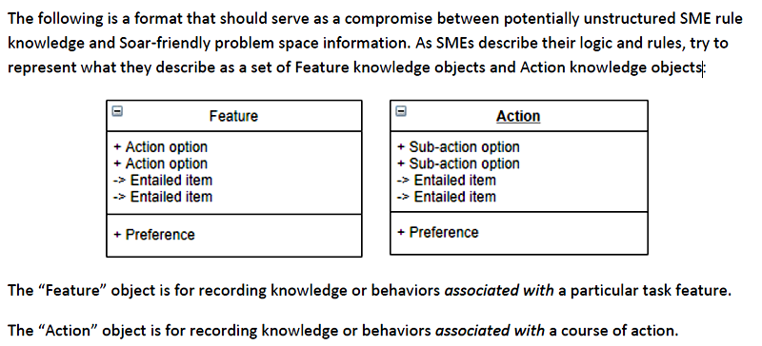
Use-Case Exploration: Pre-Diabetes (Knowledge Engineering)
Feature knowledge objects and Action knowledge objects
For use when there is NO structured data and explicit reasoning process.

Slide 12
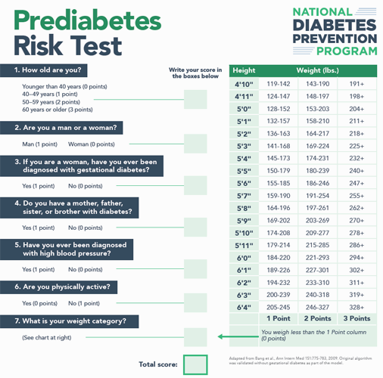
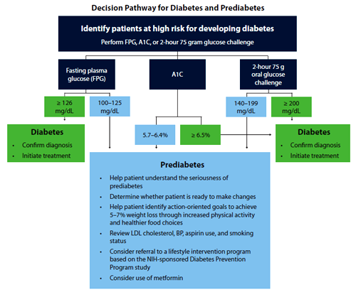
Use-Case Exploration: Pre-Diabetes (Knowledge Engineering)
Assessment Vehicles

Slide 13
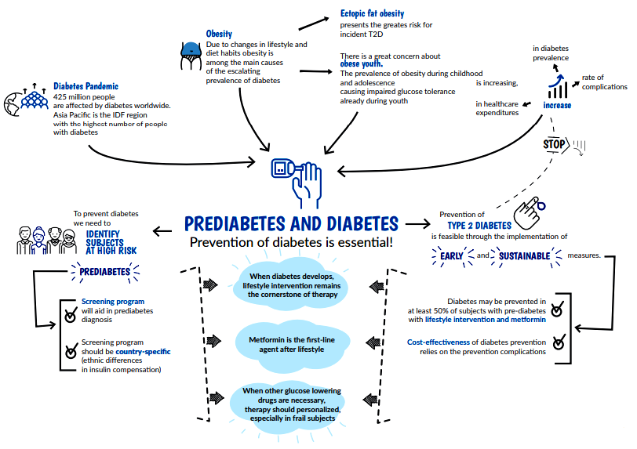
Use-Case Exploration: Pre-Diabetes (Knowledge Engineering)
Concept Map

Slide 14
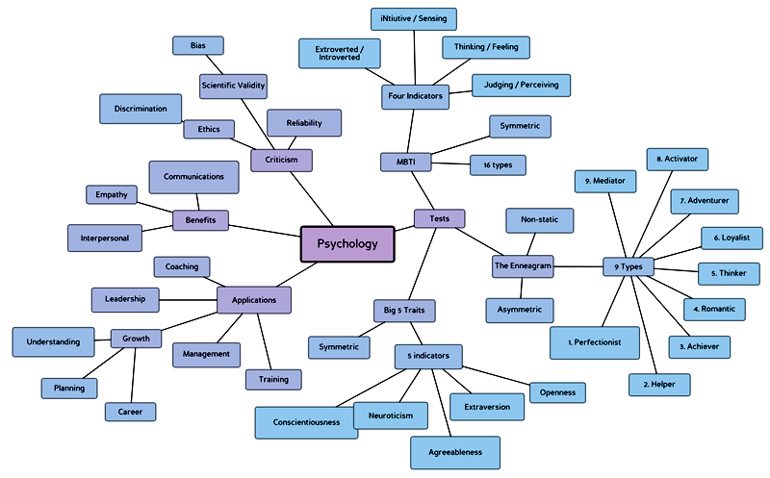
Use-Case Exploration: Pre-Diabetes (Knowledge Engineering)
Mind Map

Slide 15

Use-Case Exploration: Pre-Diabetes (Knowledge Engineering)
KE: Engagement Process
Member Assessment
Instructional Narrative
Derive
Artifacts derived from the Assessment Process
Clinical SME’s
Instructs
- Resulting -
AGI (SOAR)
Code Name: “Scottie”
Instructional Narrative
Clinical Process
“Best Practices”
Artifacts derived from the Care Plan Construction Process
Derive
Care Plan Construction
Newbie Clinical Staff Member

Slide 16
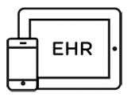
POC Process Flow
DB or ML API Call
Preemptively
Other Digitized Information
Inform the Clinical Staff of Important Patient Issues
ML Models
Clinical Staff
If needed to make decisions
Informs
SOAR Agent: “Scotty”
Omaha type
Care Plan
Single Member
Use-Case
Human Vetted Results
If needed to make decisions
Constructs
Reasoning / Explanation
Compare against Omaha Taxonomy Results or Clinical SME vetting.
Ask a Human

Slide 17
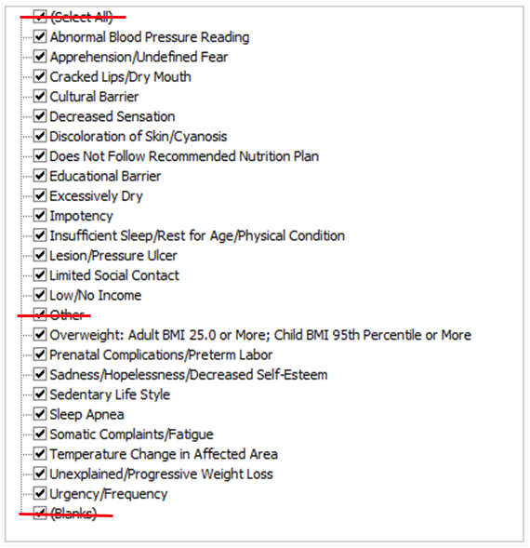
EHR/EMR : Data Dictionary (Approximation)
Omaha Taxonomy Signs and Symptoms
Omaha Taxonomy Risk Factors
(will not have Symptoms)
Race – ethnicity of identified known risk group.
Genetics – family history diabetes
Pregnancy - GDM
Reproductive Function - PCOS
Single Member
Use-Case

Slide 18
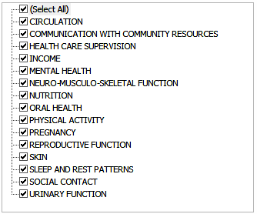
SOAR : Data Mappings
Omaha Taxonomy Signs and Symptoms
Omaha Taxonomy Problems
Omaha Taxonomy Risk Factors
(may not have Symptoms)
Race
Genetics
Pregnancy
Reproductive Function

Slide 19
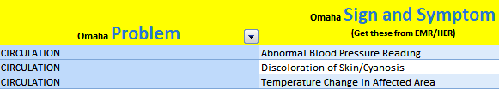
SOAR : Data Mappings
Example
Signs & Symptoms:
ABPR: Abnormal Blood Pressure Reading
DSC: Discoloration of Skin/Cyanosis
TCAA: Temperature Change in Affected Area
AUF: Apprehension/Undefined Fear
LNI: Low/No Income
Risk Factors:
RIEG: RACE - – ethnicity of identified known risk group
GEN: GENETICS - family history diabetes
MENTAL HEALTH | Apprehension/Undefined Fear
INCOME | Low/No Income
Single Member
Use-Case
Risk Factors
INCOME | Case Management | Other Community Resources | resources for obtaining recommended foods
MENTAL HEALTH | Teaching, Guidance, and Counseling | Coping Skills | identify/change factors that increase symptoms

Slide 20
Scotty : Prioritization Mechanism
EHR / EMR Record
Signs & Symptoms:
ABPR: Abnormal Blood Pressure Reading – KBS: 4,4,2
DSC: Discoloration of Skin/Cyanosis – KBS: 3,3,2
TCAA: Temperature Change in Affected Area – KBS: 4,2,3
AUF: Apprehension/Undefined Fear – KBS: 3,3,3
LNI: Low/No Income – KBS: 2,4,1
Risk Factors:
RIEG: RACE - – ethnicity of identified known risk group – KBS: 4,4,4
GEN: GENETICS - family history diabetes – KBS: 2,2,2
4. Risk Factors
First Priority
Last Priority
ABPR: Abnormal Blood Pressure Reading
DSC: Discoloration of Skin/Cyanosis
TCAA: Temperature Change in Affected Area
AUF: Apprehension / Undefined Fear
Second Priority
RIEG: RACE – ethnicity of identified known risk group
GEN: GENETICS - family history diabetes
LNI: Low/No Income
Third Priority

Slide 21
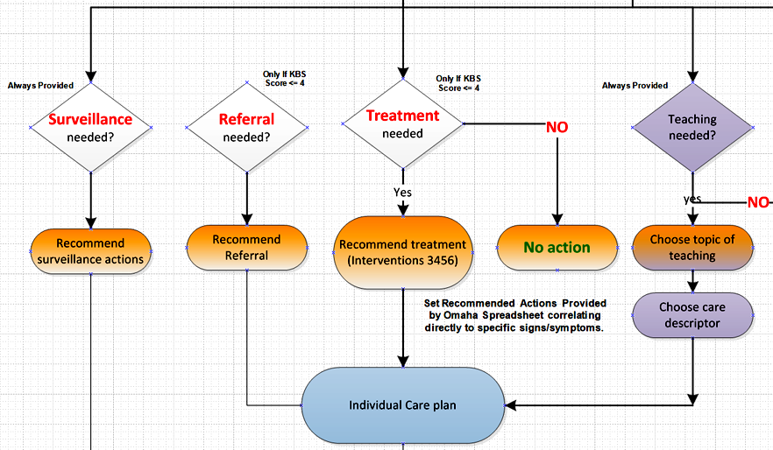
Scotty : Action Selection Process
For Each Problem and/or Risk:
Omaha System KBS Problem Rating Scale (Knowledge, Behavior, Status)
Rating: | 1 | 2 | 3 | 4 | 5
Knowledge | Ignorant | Minimal | Basic | Adequate | Superior
Behavior | Inappropriate | Rarely Appropriate | Inconsistent | Usually Appropriate | Consistent
Status | Extremely Symptoms | Severely Symptoms | Moderately Symptoms | Minimal Symptoms | No Symptoms

Slide 22
EHR/EMR : Data Dictionary
Member #
Age: #
Gender: M/F
CODE: Sign’s – Symptom’s – Risk’s
ABPR: Abnormal Blood Pressure Reading – KBS: #, #, #
AUF: Apprehension/Undefined Fear – KBS: #, #, #
CLDM: Cracked Lips/Dry Mouth – KBS: #, #, #
CB: Cultural Barrier – KBS: #, #, #
DS: Decreased Sensation – KBS: #, #, #
DSC: Discoloration of Skin/Cyanosis – KBS: #, #, #
DNFNP: Does Not Follow Recommended Nutrition Plan – KBS: #, #, #
EDB: Educational Barrier – KBS: #, #, #
EDS: Excessively Dry – KBS: #, #, #
IMP: Impotency – KBS: #, #, #
ISRAPC: Insufficient Sleep/Rest for Age/Physical Condition – KBS: #, #, #
LPU: Lesion/Pressure Ulcer – KBS: #, #, #
LSC: Limited Social Contact – KBS: #, #, #
LNI: Low/No Income – KBS: #, #, #
OWAC: Overweight: Adult BMI 25.0 or More; Child BMI 95th Percentiles or More – KBS: #, #, #
SHDSE: Sadness/Hopelessness/Decreases Self-Esteem – KBS: #, #, #
SLS: Sedentary Life Style – KBS: #, #, #
SA: Sleep Apnea – KBS: #, #, #
SCF: Somatic Complaints/Fatigue – KBS: #, #, #
TCAA: Temperature Change in Affected Area – KBS: #, #, #
UPWL: Unexplained/Progressive Weight Loss – KBS: #, #, #
UFU: Urgency/Frequency (Urination) – KBS: #, #, #
RIEG: RACE - – ethnicity of identified known risk group – KBS: #, #, #
GEN: GENETICS - family history diabetes – KBS: #, #, #
GDM: PREGNANCY-GDM – KBS: #, #, #
PCOS: REPRODUCTIVE FUNCTION-PCOS – KBS: #, #, #

Slide 23
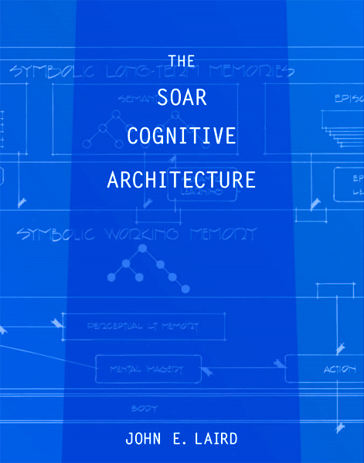

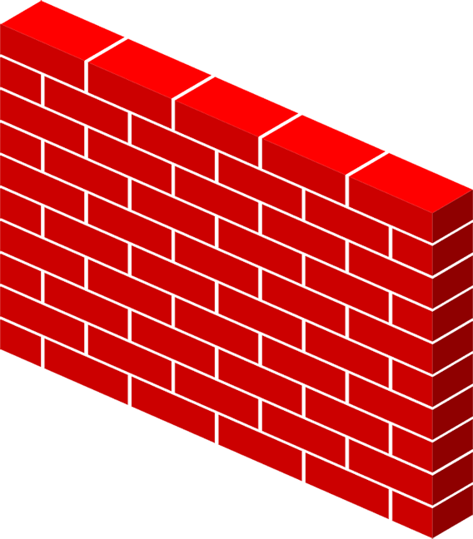

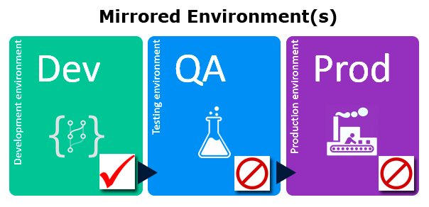
Development Plan
“The Wall”
SOAR Deliverables
Deliverables
SOAR Core Functionality
Remedial Interfaces as necessary
Mirror Dev Env Setup Assistance
Optum participation in authoring appropriate Functionality
Iterative shared development engagement.
Optum Use-Case Package
Deliverables
Clinical Use-Case Documentation
Spreadsheet(s) w/Omaha Data
Agent Decision Process Flow
Omaha Taxonomy Concept Chart
Use-Case Dev Deck PPT
Misc Documents as necessary

Slide 24
POC UI Areas and Architecture
UI Input Interface(s)
UI Output Interface
IHR
Future Potential
REST API Call
Stock MBR Use-Cases
SOAR Agent: “Scotty”
Manual MBR Use-Case Interface
Translation Process into SOAR Symbolic Inputs.
Care Plan Presentation & Reasoning Explanation
MSFT
Chat Bot Interface
Procedural
Rules
Semantic
Memory
Working
Memory

Slide 25
POC UI and Architecture
UI - Input Display
PreDiabetes Patent
Member #: 12345
Age: 52
Gender: M
Single Member
Use-Case
Signs and Symptoms:
Symptom # 1
Symptom # 2
…
Symptom # N
Variable
Length
Risks:
Risk # 1
Risk # 2
…
Risk # N
Variable
Length
MEMBER #
AGE: 52
Gender: M
ABPR: Abnormal Blood Pressure Reading – KBS: #, #, #
AUF: Apprehension/Undefined Fear – KBS: #, #, #
CLDM: Cracked Lips/Dry Mouth – KBS: #, #, #
CB: Cultural Barrier – KBS: #, #, #
DSC: Discoloration of Skin/Cyanosis – KBS: #, #, #
DNFNP: Does Not Follow Recommended Nutrition Plan – KBS: #, #, #
LPU: Lesion/Pressure Ulcer – KBS: #, #, #OWAC: Overweight: Adult BMI 25.0 or More; Child BMI 95th Percentiles or More – KBS: #, #, #
SHDSE: Sadness/Hopelessness/Decreases Self-Esteem – KBS: #, #, #
UFU: Urgency/Frequency (Urination) – KBS: #, #, #
RIEG: RACE - – ethnicity of identified known risk group – KBS: #, #, #
GEN: GENETICS - family history diabetes – KBS: #, #, #
Text File

Slide 26
POC UI and Architecture
MEMBER #
AGE: 52
Gender: M
ABPR: Abnormal Blood Pressure Reading – KBS: #, #, #
AUF: Apprehension/Undefined Fear – KBS: #, #, #
CLDM: Cracked Lips/Dry Mouth – KBS: #, #, #
CB: Cultural Barrier – KBS: #, #, #
DSC: Discoloration of Skin/Cyanosis – KBS: #, #, #
DNFNP: Does Not Follow Recommended Nutrition Plan – KBS: #, #, #
LPU: Lesion/Pressure Ulcer – KBS: #, #, #OWAC: Overweight: Adult BMI 25.0 or More; Child BMI 95th Percentiles or More – KBS: #, #, #
SHDSE: Sadness/Hopelessness/Decreases Self-Esteem – KBS: #, #, #
UFU: Urgency/Frequency (Urination) – KBS: #, #, #
RIEG: RACE - – ethnicity of identified known risk group – KBS: #, #, #
GEN: GENETICS - family history diabetes – KBS: #, #, #

Slide 27
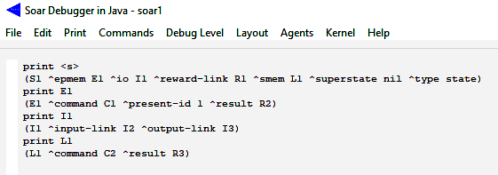
Tutorial – Problem Space Navigation
Working Memory Directed Graph: ^Edges and Nodes
1
C1
^present-id
^command
Nil
E1
^result
R2
^superstate
^epmem
^command
C2
^smem
L1
^result
R3
S1
^io
I1
^input-link
^reward-link
Nil
I2
^superstate
^type
^command
R1
^output-link
^smem
^result
L1
R3
State
I3
S1
^type
State

Slide 28
Tutorial – Problem Space Navigation
Working Memory Directed Graph: ^Edges and Nodes
1
C1
^present-id
1
C1
^command
^present-id
Nil
Nil
^command
E1
^result
R2
E1
^result
R2
^superstate
^superstate
^epmem
^epmem
^command
C2
^command
C2
^smem
^result
L1
R3
^smem
L1
^result
R3
S1
^io
I1
^input-link
S1
^io
^reward-link
^type
I2
I1
^input-link
R1
^output-link
^reward-link
I2
State
I3
^type
R1
^output-link
State
I3

Slide 29
POC WME Structures, Flow, and Mods.
MEMBER # 123456
AGE: 54
Gender: M
ABPR: Abnormal Blood Pressure Reading
LSC: Limited Social Contact
AUF: Apprehension/Undefined Fear
UFU: Urgency/Frequency (Urination)
RIEG: RACE - ethnicity of identified known risk group
^command
C2
Patient Record - Example
L1
^result
R3
^smem
topstate
S1
oss
opbm
prioritization
^omahasighsymptom
^omahaproblem
^prioritization
^code
^name
^name
^priority
^name
impotency
imp
reproductivefunction
physical
1
^imp_intervention-1
^name
surveillance
^value
Nil
category
Surveillance
^superstate
^category
^command
C2
intervention
^name
signssymptomsphysical
^smem
L1
^result
^target
R3
target
^value
Signs/Symptoms-Physical
S1
^type
State
^caredescriptor
^name
erectiledysfunction
caredescriptor
^value
Erectile Dysfunction

Slide 30
POC WME Structures with Omaha Taxonomy SMem DG.
^command
C2
Omaha Taxonomy SMem KB Structure
L1
Stock SOAR WME’s
^result
R3
(state <s> ^name omaha_taxonomy_smem ^current-item <root>)
(<root> ^omahasignsymptom <oss>)
(<oss> ^name <oss_name>)
(<oss> ^name |Impotency|) # Example
(<oss> ^code <oss_code>)
(<oss> ^omahaproblem <opbm>)
(<opbm> ^name |reproductivefunction|) # Example
(<opbm> ^name <opbm_name>)
(<opbm> ^prioritization <prioritization>)
(<prioritization> ^name <pri_name>)
(<prioritization> ^name |physical|) # Example
(<prioritization> ^priority <pri_value>)
(<prioritization> ^priority 1) # Example
# Below: Each OSS has 1 or more "touples" = "Intervention".
(<oss> ^imp_intervention-1 <intervention>)
(<intervention>
^category.name surveillance <category_name>
^category.value <category_value>
^target.name signssymptomsphysical <target_name>
^target.value <target_value>
^caredescriptor.name erectiledysfunction <caredescriptor_name>
^caredescriptor.value <caredescriptor_value>)
^smem
Omaha Taxonomy WME’s + Priority
topstate
S1
oss
opbm
prioritization
^omahasighsymptom
^omahaproblem
^prioritization
^code
^name
^name
^priority
^name
impotency
imp
reproductivefunction
physical
1
….
^imp_intervention-1
^name
surveillance
category
^value
Surveillance
^category
intervention
^name
signssymptomsphysical
Additional WME’s to implement
Care Plan “Interventions”.
^target
^value
target
Signs/Symptoms-Physical
^caredescriptor
^name
erectiledysfunction
caredescriptor
^value
Erectile Dysfunction

Slide 31
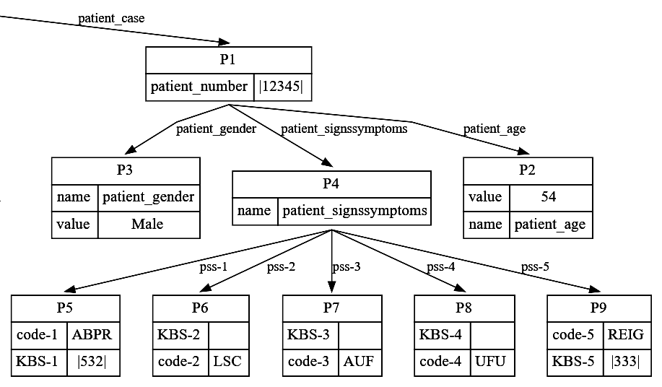
POC WME Structures with Patient WME Structure.
MEMBER # 123456
AGE: 54
Gender: M
ABPR: Abnormal Blood Pressure Reading: Circulatory KBS 532
LSC: Limited Social Contact
AUF: Apprehension/Undefined Fear
UFU: Urgency/Frequency (Urination): KBS 333
RIEG: RACE - ethnicity of identified known risk group
Omaha Taxonomy Patient Use-Case
Knowledge Base Structure
Patient Record - Example
(<s> ^patient_case <patientcase>)
(<patientcase> ^patient_number <patient_number>
^patient_age <patient_age>
^patient_gender <patient_gender>
^patient_signssymptoms <patient_signssymptoms>)
(<patient_number> ^name patient_number ^value |12345|)
(<patient_age> ^name patient_age ^value 54)
(<patient_gender> ^name patient_gender ^value |Male|)
(<patient_signssymptoms> ^name patient_signssymptoms ^pss-1 <pss-1>
^pss-2 <pss-2>
^pss-3 <pss-3>
^pss-4 <pss-4>
^pss-5 <pss-5>)
(<pss-1> ^code-1 |ABPR| ^KBS-1 |532|)
(<pss-2> ^code-2 |LSC| ^KBS-2 ||)
(<pss-3> ^code-3 |AUF| ^KBS-3 ||)
(<pss-4> ^code-4 |UFU| ^KBS-4 ||)
(<pss-5> ^code-5 |REIG| ^KBS-5 |333|)

Slide 32
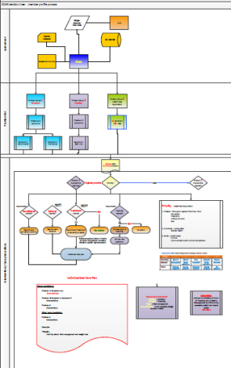
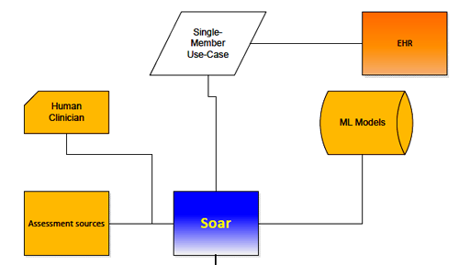
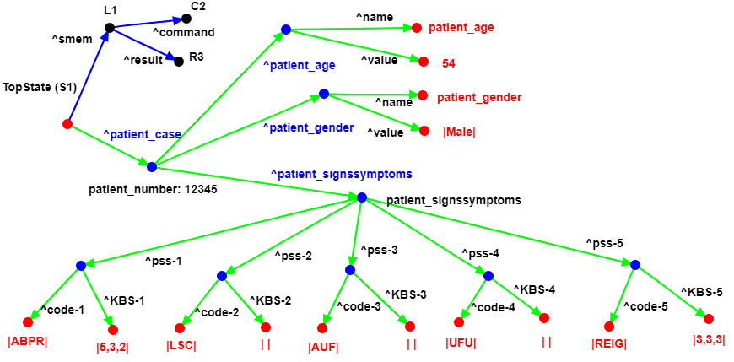
POC WME Structures, Flow, and Mods #1.
SCOTTY Phase #1
SCOTTY Phase #1
The SOAR Agent ingests a patient use-case and instantiates that into Working Memory. The resulting WM structure (in green) of that patients use-case is below. Note: Some S&S might not have a KBS associated.
MEMBER # 123456
AGE: 54
Gender: M
ABPR: Abnormal Blood Pressure Reading: Circulatory KBS 532
LSC: Limited Social Contact
AUF: Apprehension/Undefined Fear
UFU: Urgency/Frequency (Urination): KBS 333
RIEG: RACE - ethnicity of identified known risk group
Patient Record - Example
WME’s Directed Graph of example patient use-case.
SOAR WME’s Directed Graph of a patient use-case.

Slide 33
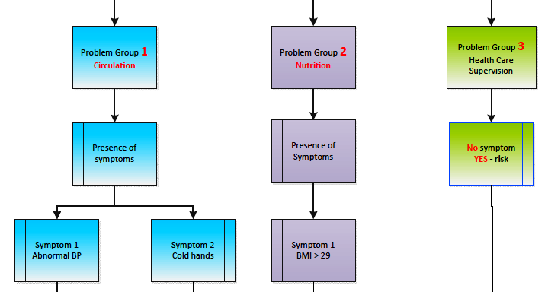
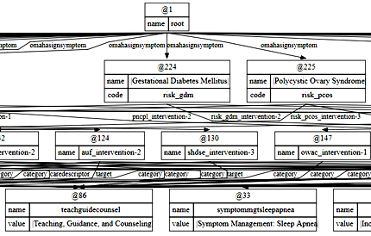
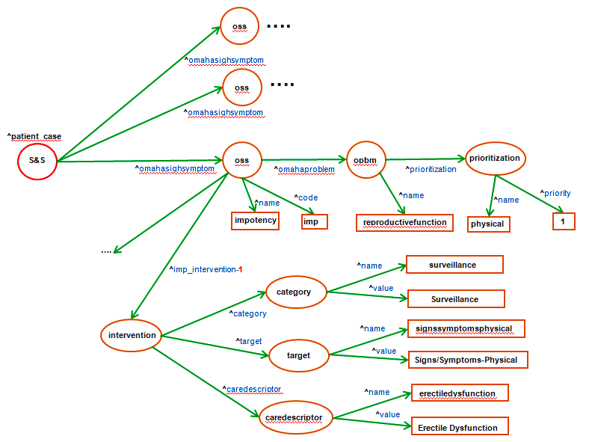
POC WME Structures, Flow, and Mods #2a.
SCOTTY Phase #2
SCOTTY Phase #2
1. For Each Patient S&S in WM, match them with Omaha Taxonomy S&S via the SMem Root Node in WM to fetch the corresponding Omaha Problem DG and it's corresponding Priority.
2. Curate the results of that into a new WM structure that can be easily located, retrieved, and sorted / ranked.
SOAR SMem of the Omaha Taxonomy Pre-diabetes knowledge.
MEMBER # 123456
AGE: 54
Gender: M
ABPR: Abnormal Blood Pressure Reading: Circulatory KBS 532
LSC: Limited Social Contact
AUF: Apprehension/Undefined Fear
UFU: Urgency/Frequency (Urination): KBS 333
RIEG: RACE - ethnicity of identified known risk group
Patient Record - Example
SOAR WME’s Directed Graph of example patient use-case.

Slide 34
POC WME Structures, Flow, and Mods #2b.
….
SCOTTY Phase #2
oss
^omahasighsymptom
….
oss
^omahasighsymptom
^patient_case
S&S
^omahasighsymptom
oss
^omahaproblem
opbm
prioritization
^prioritization
^name
^code
^name
^name
^priority
impotency
imp
reproductivefunction
physical
1
….
^imp_intervention-1
^name
surveillance
category
^value
Surveillance
^category
intervention
^name
signssymptomsphysical
^target
^value
target
Signs/Symptoms-Physical
^caredescriptor
^name
erectiledysfunction
caredescriptor
^value
Erectile Dysfunction

Slide 35
POC WME Structures, Flow, and Mods #3.
Receive a WME structure with a root element to access it.
Force Rank that WME according to the Omaha Taxonomy Problem Priority.
Create a new WME that will hold the resultant Care Plan for this patient.
The Care Plan is organized by S&S + Intervention and includes Risks and an Explanation of Reasoning.
For-Each S&S (highest rank to lowest) check the KBS score composite and determine if a Referral and/or Treatment is warranted.
If the Referral and/or Treatment is warranted, then include them in the “Intervention” portion of the Care Plan WME.
SCOTTY Phase #3

Slide 36
POC WME Structures, Flow, and Mods.
(state <s> ^name omaha_taxonomy_smem ^current-item <root>)
(<root> ^omahasignsymptom <oss>)
(<oss> ^name <oss_name>)
(<oss> ^name |Impotency|) # Example
(<oss> ^code <oss_code>)
(<oss> ^omahaproblem <opbm>)
(<opbm> ^name |reproductivefunction|) # Example
(<opbm> ^name <opbm_name>)
(<opbm> ^prioritization <prioritization>)
(<prioritization> ^name <pri_name>)
(<prioritization> ^name |physical|) # Example
(<prioritization> ^priority <pri_value>)
(<prioritization> ^priority 1) # Example
# Below: Each OSS has 1 or more "touples" = "Intervention".
(<oss> ^imp_intervention-1 <intervention>)
(<intervention>
^category.name surveillance <category_name>
^category.value <category_value>
^target.name signssymptomsphysical <target_name>
^target.value <target_value>
^caredescriptor.name erectiledysfunction <caredescriptor_name>
^caredescriptor.value <caredescriptor_value>)
MEMBER # 123456
AGE: 54
Gender: M
ABPR: Abnormal Blood Pressure Reading: Circulatory KBS 532
LSC: Limited Social Contact
AUF: Apprehension/Undefined Fear
UFU: Urgency/Frequency (Urination): KBS 333
RIEG: RACE - ethnicity of identified known risk group
Patient Record - Example

Slide 37
POC WME Structures, Flow, and Mods.

Slide 38
POC WME Structures, Flow, and Mods.

Slide 39
POC WME Structures, Flow, and Mods.

